Slide 1






AI
In Smart Cities & Transportation
21-Jun-2025
Alfredo, Richard, Ola, Khizar

Slide 2

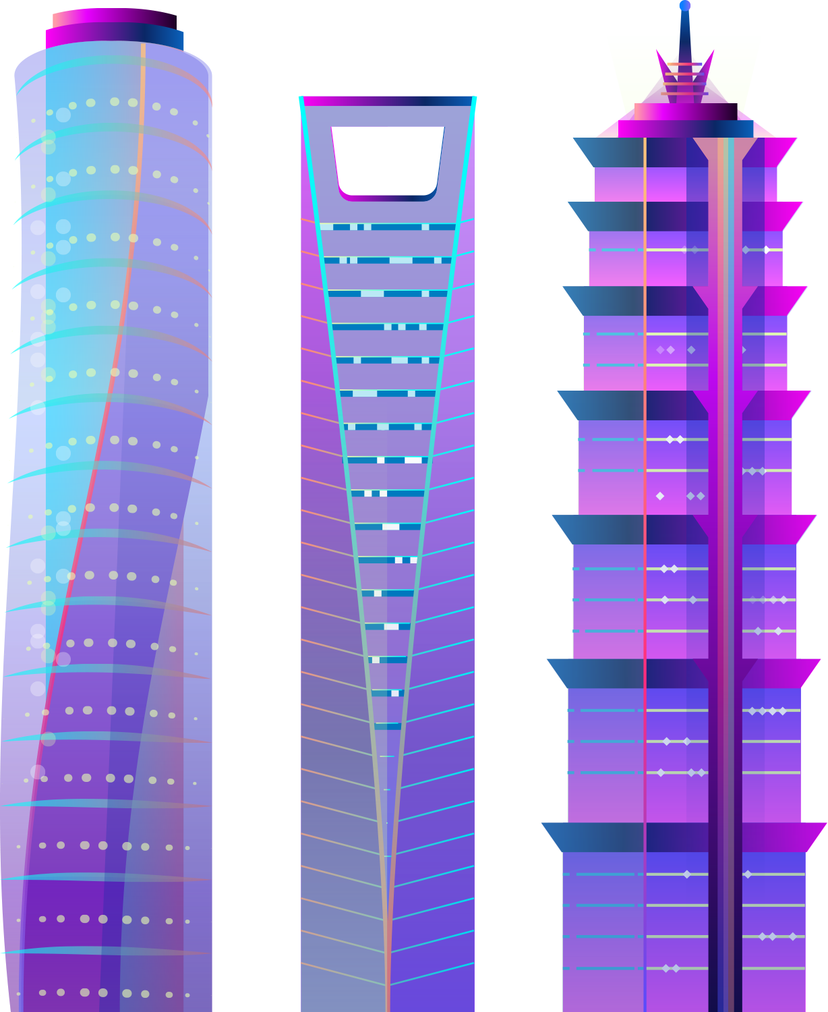
What is a Smart City?
Tech everywhere
City with a brain
A safe space to grow
A smart city is basically a city that uses technology to work better for the people who live there. That might mean sensors that help manage traffic, so you’re not stuck at every red light, or trash bins that tell the city when they’re full so pickups happen only when needed. It’s about making daily life smoother and more efficient, using data and tools in the background that most folks don’t even notice.
Think of it like this: imagine your city having a brain. It collects info—like traffic jams, energy use, weather, pollution—and uses that info to make decisions in real time. It's trying to stay ahead of problems instead of just reacting to them.
But the goal isn’t just tech for tech’s sake. It’s about improving quality of life—safer streets, cleaner air, better transit, and making sure the city grows in a way that actually helps the people living in it.

Slide 3




Why AI in our cities?
1
2
3
Less Traffic, Less Waiting
Safer Neighborhoods
Smarter Use of Resources
AI can time traffic lights better, spot jams early, and suggest faster routes—so commutes get shorter and smoother.
With smart cameras and pattern detection, AI can help spot accidents or suspicious activity faster, which helps emergency services respond quickly.
AI can monitor things like energy, water, and waste systems to prevent overuse or breakdowns—saving money and reducing waste.

Slide 4



AI Use Case Smart Cities
Advanced Metering Infrastructure (AMI)
Utilities service providers such as Pacific Gas & Electric (PGE) have deployed millions of smart meters with aim of providing real-time data on electricity usage, enabling time of use pricing, outage detection and accurate billing
.
Companies are using smart grid technology to automatically reduce electricity usage during peak demand periods.
Companies are using smart grid systems to monitor solar and wind power. AI helps to balance supply and demand where necessary..
Demand Response
Renewable Energy
Notes:
The result? Less congestion, shorter travel times, and lower emissions. In Pittsburgh, for example, adaptive traffic signals powered by AI reduced travel time by over 25% and idling time by more than 40%.

Slide 5
AI Use Case Smart Cities
Real Time Grid Monitoring & Analytics
Deployment of digital ”Smart Operations Center to monitor AI grid health providing real-time data on equipment failures.
.
Microgrid projects are being used in cities in US to generate, store, and trade energy locally using blockchain and smart grid technology.
Utility service providers are using smart grid technology to schedule EV charging during off peak hours, reducing loads on the grid and influencing lower electricity rates.
Microgrids
EV Integration
Notes:
The result? Less congestion, shorter travel times, and lower emissions. In Pittsburgh, for example, adaptive traffic signals powered by AI reduced travel time by over 25% and idling time by more than 40%.

Slide 6
AI Use Case Smart Cities
Public Safety and Security
AI helps to detect intrusions, emergencies. Algorithms identify crime hotspots deploying resources faster by analyzing alerts and geolocation.
.
Air quality monitoring, waste management and water management. AI analyzes sensor data to detect pollution, optimize garbage collection routes and detect leaks.
Telemedicine integration and emergency resource allocation. AI supports doctors with diagnosis and allocates disaster response more effectively.
Environmental Monitoring
Healthcare and Emergency Services
Notes:
The result? Less congestion, shorter travel times, and lower emissions. In Pittsburgh, for example, adaptive traffic signals powered by AI reduced travel time by over 25% and idling time by more than 40%.

Slide 7
AI Use Case Transportation
Already adopted in cities like Barcelona and Pittsburgh, AI systems analyze real-time data from traffic cameras, sensors, and GPS to understand how vehicles and pedestrians are moving through intersections.
Traffic flow prediction and incident detection. AI systems adjust predicts peak hours with suggestion of alternate routes. It monitors traffic cameras to quickly identify accidents or stalled vehicles.
Self driving cars and driver assistance systems. A rollout of Tesla robotaxi in Austin yesterday supports Ai’s interpretations of sensor data (LIDAR, camera) to safe driving. AI supports features like lane keeping, adaptive cruise control and autobrake.
AI-Powered Traffic Signal Optimization
Traffic Management
Autonomous vehicles (Avs)
Notes:
The result? Less congestion, shorter travel times, and lower emissions. In Pittsburgh, for example, adaptive traffic signals powered by AI reduced travel time by over 25% and idling time by more than 40%.

Slide 8
AI Use Case Transportation
Demand forecasting, dynamic routing and smart ticketing. AI can help with prediction of demand to optimize bus/train frequency and real time adjustments of route due to road closure or conditions.
Route maximization, predictive maintenance and autonomous delivery robots/drones. AI will find most efficient delivery routes based on traffic, delivery windows and will detect vehicle issues before breakdowns.
License plate recognition and driver monitoring systems. AI will track atighue or distraction in commercial drivers. Collates data for tolls, traffic enforcement and crime tracking. driving.
Public Transportation
Logistics & Freight
Safety & Compliance
Notes:
The result? Less congestion, shorter travel times, and lower emissions. In Pittsburgh, for example, adaptive traffic signals powered by AI reduced travel time by over 25% and idling time by more than 40%.

Slide 9

Techniques Used
Swarm Intelligence
Reinforcement Learning
Federated Learning
Digital Twins with AI
Helps coordinate fleets of autonomous vehicles or drones.
AI learns by trail-and-error.
This technique trains AI models locally (like on edge devices or vehicles) and then shares only the learned patterns.
A virtual replica of a city or system. Like a sandbox for city planners to test ideas before making them real.
Notes:
Swarm
It’s used in traffic simulations and decentralized routing where no single system controls everything, but the group behaves intelligently.
Reinforced Learning
Perfect for optimizing traffic signals or autonomous driving in complex environments. The system gets better over time by learning what actions lead to smoother flow or fewer accidents.
Federated Learning Used instead of sending all data to a central server, it’s great for privacy-sensitive applications like smart surveillance or personal mobility data.
Digital Twins with AI When combined with AI, it can simulate how changes—like rerouting traffic or adjusting energy usage—would play out in real life. These techniques are a bit more specialized, but they’re gaining traction as cities get more connected and complex.

Slide 10
Techniques Used
Machine Learning
Computer Vision
Natural Language programming
Sensor Fusion
Supports predictive analysis or traffic, energy consumption and pollution levels.
Interprete inputs from LIDAR, GPS, and cameras in Avs providing accurate environment modeling for autonomous driving
Provides real-time interpretation of video data for surveillance, traffic and waste management.
Usage of chatbots, virtual assistants, and sentiment analysis
Notes:
Swarm
It’s used in traffic simulations and decentralized routing where no single system controls everything, but the group behaves intelligently.
Reinforced Learning
Perfect for optimizing traffic signals or autonomous driving in complex environments. The system gets better over time by learning what actions lead to smoother flow or fewer accidents.
Federated Learning Used instead of sending all data to a central server, it’s great for privacy-sensitive applications like smart surveillance or personal mobility data.
Digital Twins with AI When combined with AI, it can simulate how changes—like rerouting traffic or adjusting energy usage—would play out in real life. These techniques are a bit more specialized, but they’re gaining traction as cities get more connected and complex.

Slide 11

Case Study
The Challenge
Singapore is a small island nation with limited space and a growing population (estimated at 5.87 million people - with over 1,008,318 registered vehicles in Singapore). Building more roads wasn’t a sustainable option, so the government needed smarter ways to manage traffic and mobility.
The Solution: Intelligent Transport System (ITS)
The ITS is a suite of technologies that work in unison to monitor, manage and optimize traffic flow. Some key components were:
Electronic Road Pricing (ERP) is a dynamic tolling system that automatically charges drivers higher fees during peak hours to help manage congestion.
GLIDE is an AI-based traffic light system that adjusts green light timing in real time to improve traffic flow.
EMAS uses cameras and sensors to detect accidents or breakdowns and then dispatches assistance while updating digital signs with route information.
iTransport is a smart system that pulls together info from across the city so operators can make better decisions and keep commuters in the loop with real-time updates.
Notes:
That means about 1 in 5.8 people owns a car.
Cars & Station Wagons: 568,463 Private Hire Cars: 92,019
Taxis: 12,846
Motorcycles & Scooters: 148,791
Goods & Other Vehicles (like light/heavy trucks and vans): 167,462
Buses (public, private, school, etc.): 18,737
So while the number of private cars is around 568,000, the full vehicle ecosystem—when you include commercial, public, and two-wheelers—pushes the total well past the 1 million mark.
GLIDE = Green Link Determining System
EMAS - Expressway Monitoring and Advisory System
iTransport - like traffic, accidents, and road conditions

Slide 12


Impact
The city of Pittsburgh put in traffic lights that adjust on their own, based on how busy the roads are. This helped cut travel time by 25% and reduced how long cars sit in traffic by over 40%
Benefits
AI can help spot accidents or dangerous situations faster, so emergency crews can get there quickly and prevent bigger problems.
By easing traffic and improving public transit timing, AI helps save fuel, cut pollution, and make commuting more reliable.
Anecdotal feedback and pilot studies did highlight positive public perception
Notes:
Anecdotal feedback is what people share based on their personal experiences—not through formal surveys or data collection, but through everyday comments, stories, or reactions.

Slide 13

Challenges
AI systems need a lot of high-quality, real-time data to work well—but collecting that data across an entire city can be expensive, complicated, and raise privacy concerns.
Risks
If an AI system misinterprets data—like failing to detect a pedestrian or misjudging traffic flow—it could lead to safety issues, such as accidents or poor emergency response.

Slide 14

Future Trends
Autonomous Delivery and Freight: Cities are starting to adopt self-driving delivery vehicles and drones for last-mile logistics. This reduces traffic from large trucks and speeds up deliveries—especially in dense urban areas.
Right now, Walmart is leading the charge in adopting delivery drones at scale in the U.S. They have completed over 150,000 drone deliveries since 2021. The drones deliver items like groceries, medicine, and small electronics in 30 minutes or less, with a range of up to six miles from each store
Notes:
Last-mile logistics refers to the final step of a delivery journey—getting a package from a local hub to your doorstep.
It’s often the most expensive and complex part of the process because it deals with traffic, unpredictable routes, and customer availability.
It’s expanding to five major metro areas—Atlanta, Charlotte, Houston, Orlando, and Tampa—through a partnership with Wing, a drone company owned by Alphabet (Google’s parent).
The rollout includes 100 stores, making it the largest retail drone delivery expansion in the U.S. to date.

Slide 15

Video Demo
How Are Cities Around the World Utilizing Artificial Intelligence?
http://youtube.com/watch?v=Y61fxXaHIZ0

Slide 16

Conclusion
AI is rapidly transforming smart cities and transportation by making streets safer, commutes faster, and services more efficient—from Singapore’s adaptive traffic signals to Walmart’s drone deliveries. As cities adopt these innovations, the challenge lies in balancing tech progress with public trust, clear policies, and practical impact
on daily life.

Slide 17
References:
Alea IT Solutions. (2024, February 29). Singapore introduces AI-powered traffic management system: A step towards smart city success. https://www.aleaitsolutions.com/singapore-introduces-ai-powered-traffic-management-system-a-step-towards-smart-city-success/
Apolitical. (2021, January 12). Pittsburgh cuts travel time by 25% with smart traffic lights. https://apolitical.co/solution-articles/en/pittsburgh-cuts-travel-time-25-smart-traffic-lights
AskPython. (2024). The role of AI in advancing public safety and security. https://www.askpython.com/resources/role-of-ai-in-advancing-public-safety-security
City of Los Angeles. (n.d.). Traffic data | City of Los Angeles Geohub. https://geohub.lacity.org/datasets/lahub::traffic-data/about
Deloitte. (2024, March). AI-powered cities of the future. https://www.deloitte.com/us/en/Industries/government-public/research/ai-powered-cities-of-future.html
FPGA Insights. (2024). AI in smart cities: Advancing urban sustainability. https://fpgainsights.com/artificial-intelligence/ai-in-smart-cities/
Forbes. (2024, June 26). Urban digital twins: AI comes to city planning. https://www.forbes.com/sites/delltechnologies/2024/06/26/urban-digital-twins-ai-comes-to-city-planning/
Harvard Kennedy School. (2020, June 11). How smart city Barcelona brought the Internet of Things to life. Data-Smart City Solutions. https://datasmart.hks.harvard.edu/news/article/how-smart-city-barcelona-brought-the-internet-of-things-to-life-789
Learn Architecture. (2024). How AI revolutionizes urban sustainability. https://learnarchitecture.net/sustainability/5052-how-ai-revolutionizes-urban-sustainability.html
Land Transport Authority. (n.d.). Intelligent transport systems. https://www.lta.gov.sg/content/ltagov/en/getting_around/driving_in_singapore/intelligent_transport_systems.html
AA Highway. (n.d.). Riding the green wave: The impact of Singapore’s GLIDE system on urban traffic management. https://aa-highway.com.sg/riding-the-green-wave-the-impact-of-singapores-glide-system-on-urban-traffic-management/:

